Slide 1


Slide 2





Slide 3
40%
using AI to make diagnoses
reduce treatment costs by up to:
improve health outcomes by
50%
Source: IBM
Notes:
https://www.who.int/news-room/fact-sheets/detail/tuberculosis

Slide 4
1 600 000
74 000 000
Facts
People Die each year from TB
People Die each year from TB
Lives were saved through TB diagnosis
Source: WHO
Notes:
https://www.who.int/news-room/fact-sheets/detail/tuberculosis

Slide 5
Problem statement
Tuberculosis, a potentially life-threatening disease, affects millions worldwide.
Timely detection and treatment are crucial for controlling its spread and improving patient outcomes.

Slide 6
Overview
To tackle this challenge, we utilized a comprehensive dataset comprising X-ray images.
The dataset was sourced from Kaggle, and it provides a diverse collection of images for model training and evaluation.

Slide 7
Project Goals
Develop a Machine Learning Model
Achieve High Accuracy
Ensure Reliability
Assist in Early Diagnosis
Support Healthcare Systems

Slide 8
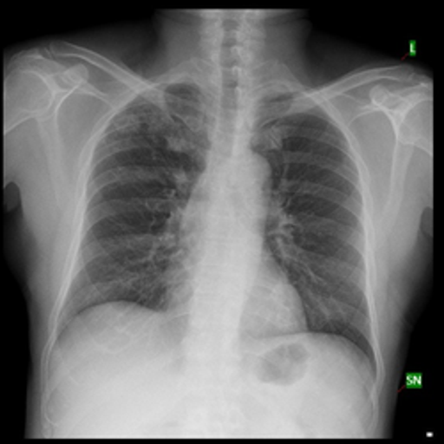
Tuberculosis (TB) Chest X-Ray Database
The Dataset consist of 4200 images from Kaggle.
3500 picture identifies a normal chest X-Ray.
While 700 shows an infected Tuberculosis X-Ray.

Slide 9
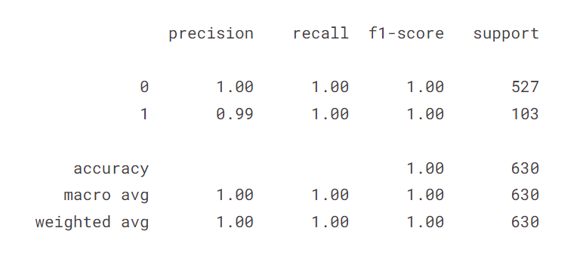
PROGRESS CHART

Slide 10
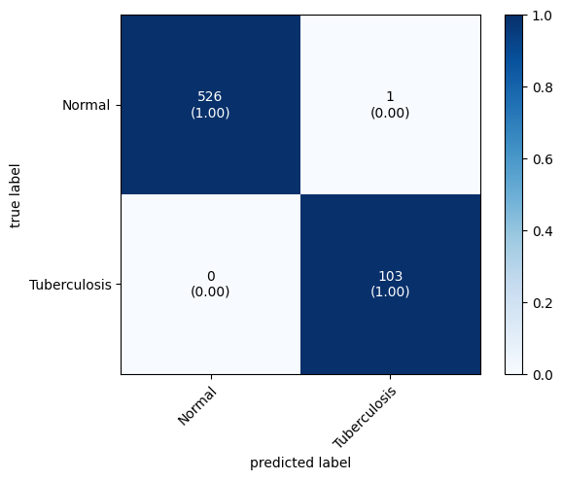
Heat Map

Slide 11
Current work | Future Improvements
Data Preprocessing
Model
Training
Model Evaluation
Collaboration with Healthcare Professionals
Collect more diverse data
Model Deployment

Slide 12
Challenges
Not enough Computing power
Time limitations
Lack of datasets
Access to healthcare professionals

Slide 13


Slide 14
Thanks!
Any Questions?

